Slide 1
Flight Booking Management System
A Flight Reservation System using C Programming

Slide 2
Introduction
Air travel is a common mode of transportation.
A flight booking system helps users book tickets efficiently.
This project is a simple console-based application allowing:
* View available flights
* Book tickets
* View booked tickets
* Cancel tickets (optional)

Slide 3
Abstract
C-based Flight Booking System for managing ticket reservations.
Stores flight data and allows users to book, view, and manage bookings.
Uses arrays for simplicity but can be extended to databases.
Ensures seat availability validation before booking.
Provides a basic reservation system using C programming.

Slide 4
Language Used for this Project
C Language
Features Used:
1)Structures: For storing flight and booking details.
2)Functions: Modular design for efficient management.
3)Loops & Conditions: To handle user inputs dynamically.

Slide 5
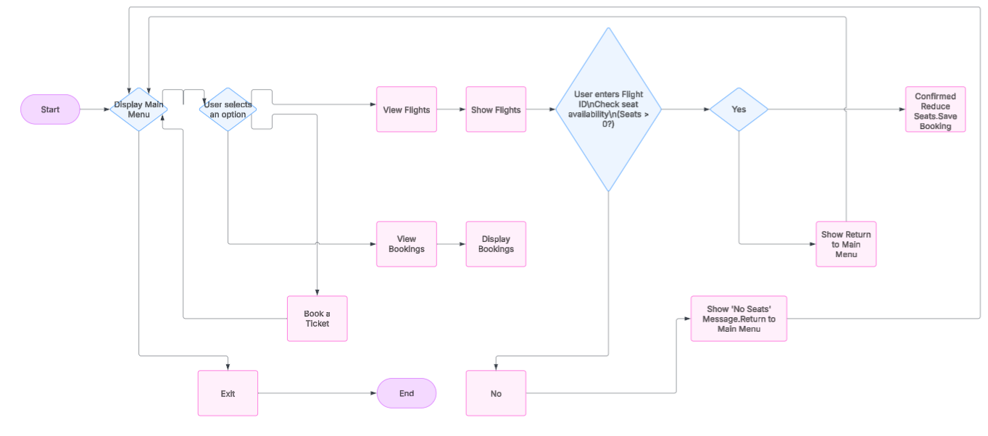
WORKFLOW

Slide 6
Advantages & Disadvantages
✅ Advantages:
Simple and easy to use
Fast execution
Good for learning C programming
Can be extended with databases or GUI
❌ Disadvantages:
Limited features (No online payments or seat selection)
No real-time updates (Manual data handling)
Text-based interface (No GUI)

Slide 7
References
GeeksforGeeks – C Programming
TutorialsPoint – C File Handling
Online documentation on C programming

Slide 8
Conclusion
The Flight Booking Management System is a simple and effective project.
It allows users to book, view, and manage flight tickets using C.
Demonstrates key C programming concepts like file handling, structures, and functions.
Can be extended into a real-world booking system with more features.

Slide 9
Future Work
Graphical User Interface (GUI) for better user experience.
Database Integration (MySQL, SQLite) for efficient data storage.
Payment System for online ticket purchases.
Seat Selection Feature for a better booking experience.
User Authentication System for security and personalized booking.

